Slide 1
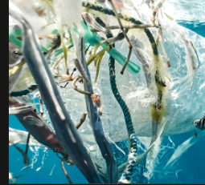
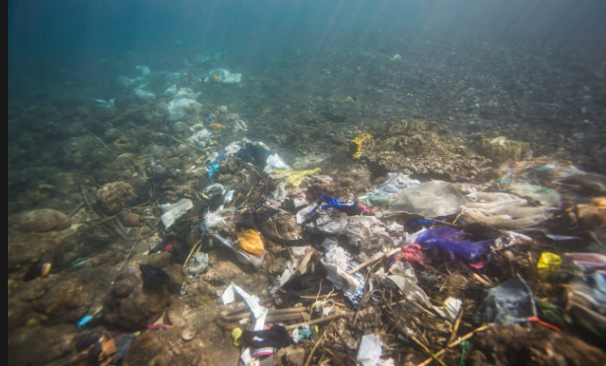
Since A whopping 91% of reculced billion of tons fo plastic have been made over th past decased which much of it is becoming trash and litter

Slide 2
Since 1950 to 2018, about 6.3 billion tonnes of plastic have been produced worldwide, 9% to 12% of which have been recycled and incinerated respectively.
According to Alabi et al. an estimated 8 million tonnes of plastic is yearly released into the ocean, leading to the degradation of marine habitats which eventually affects aquatic organisms. It has been estimated by 2050 oceans might contain more plastics than fish in terms of weight.
About 5 million tonnes of plastics are yearly consumed in the UK alone, with only about one on-quarter recycled and the rest landfilled

Slide 3
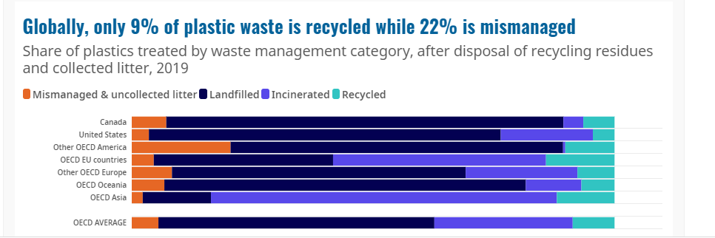
Reprocessing of recovered plastic scraps or wastes into usable products is called plastic recycling.
Recycling of plastics is a major aspect of the worldwide efforts in minimizing the yearly 8 million tonnes of plastics in the waste stream entering the Earth's ocean
Advances in technologies and systems for the collection, sorting and reprocessing of recyclable plastics are creating new opportunity for recycling and combined actions of the public, industry and governments it may be possible to divert the majority of plastic waste from landfills to recycling over the next decades

Slide 4
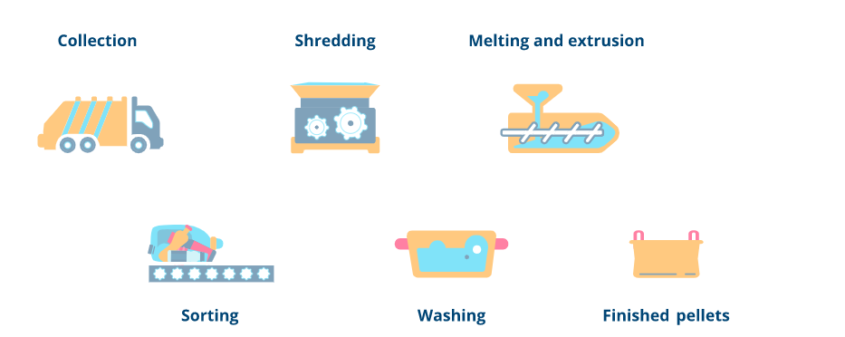
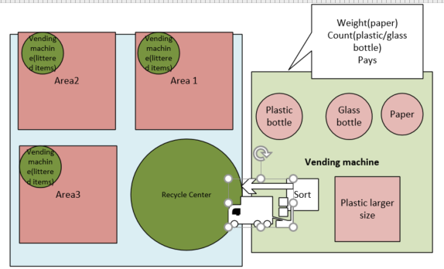
Current process (9%) of plastics are recycled
Suggested process

